Slide 1

Atliq Hospitality Analysis
Overview for May To July 2022
Presented by
Atharv Yadav
Pratiksha Jadhav
Shaikh Mohsin

Slide 2
Dataset Details
We are provided with 3 Months(i.e.May,June and July) booking details data of the Atliq hotels based in Mumbai, Bangalore, Delhi and Hyderabad.
Dataset contains 5 CSV Files.
dim_date
dim_hotels
dim_rooms
fact_aggregated_bookings
fact_booking
Metric list excel file.

Slide 3
Company Overview
Hotels
Atliq Bay
Atliq Blu
Atliq City
Atliq Exotica
Atliq Grands
Atliq Palace
Atliq Seasons
City
Hyderabad
Bangalore
Delhi
Mumbai
Category
Standard
Elite
Premium
Presidential
BOOKING
PLATFORMS
Direct Offline
Direct Online
Journey
LogTrip
MakeyourTrip
Tripster
Others

Slide 4
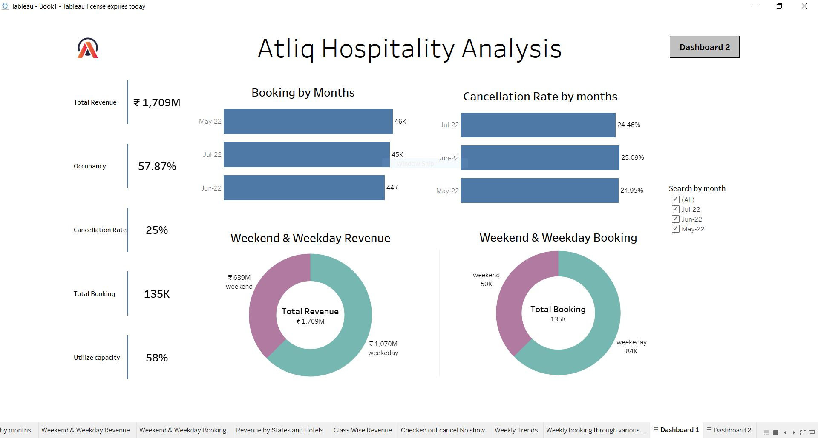
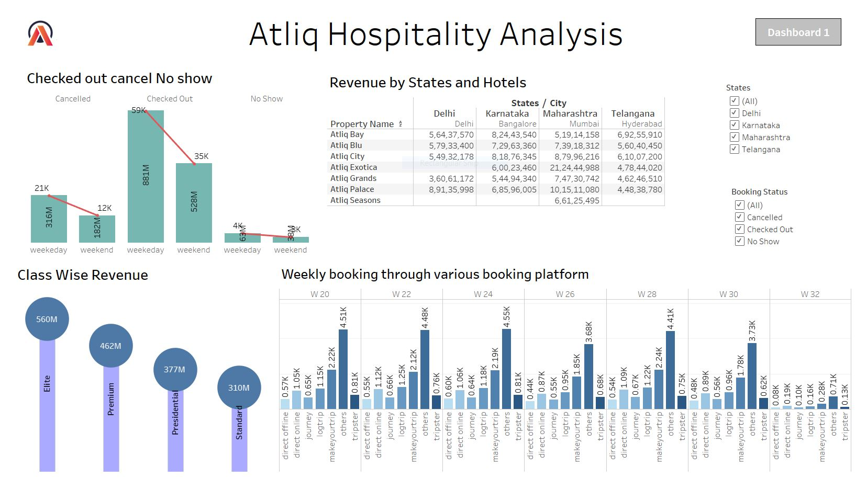
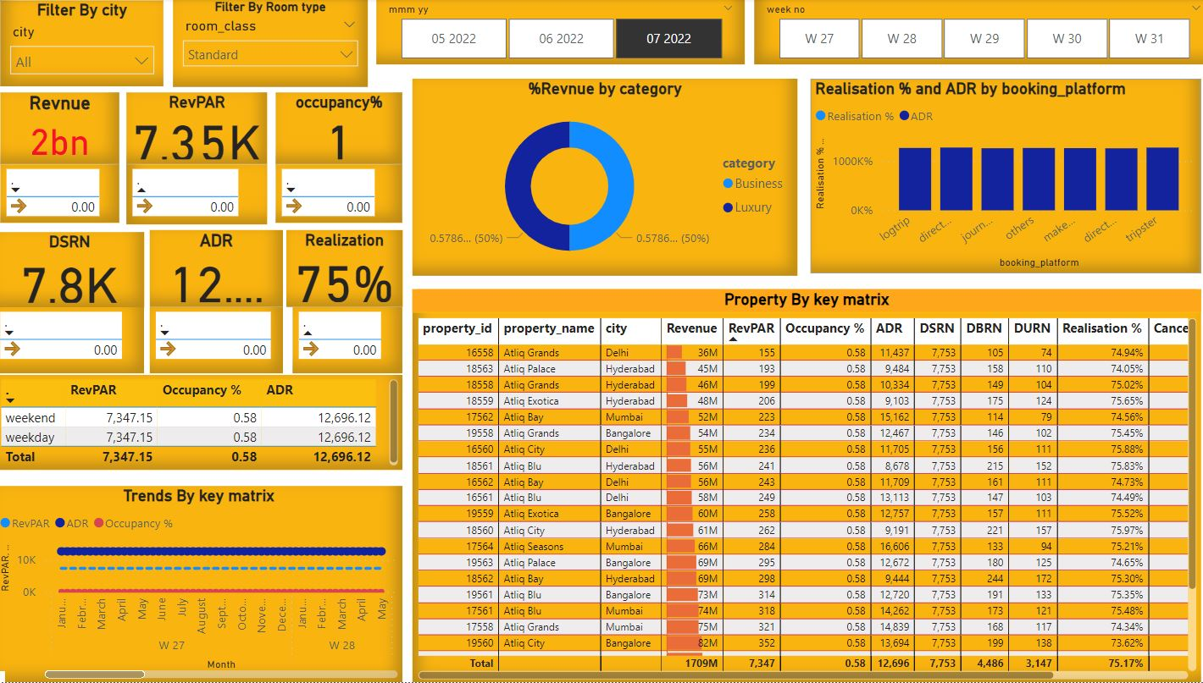
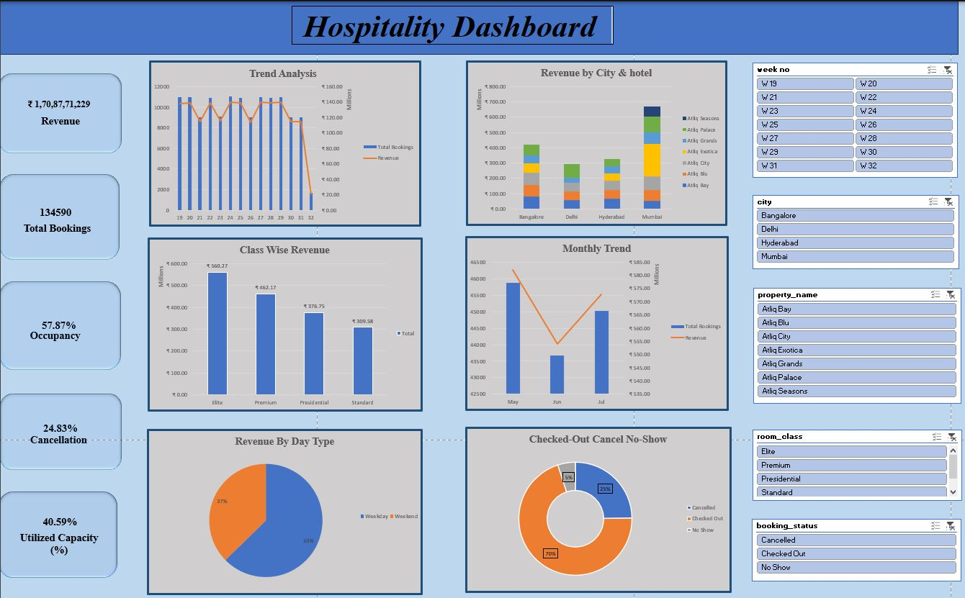

Slide 5

Key Performance Metrics
1,709M
Total Revenue : The revenue generated from room bookings
57.87%
Occupancy : The percentage of available rooms that were booked
25%
Cancellation Rate : The percentage of total bookings that were canceled within a given period
135K
Total Booking : available resources (i.e. rooms) that are actually used during a specific period
40.95%
Utilize capacity : refers to the portion of available rooms that are booked and occupied by guests.

Slide 6
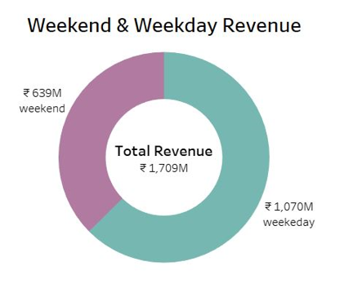
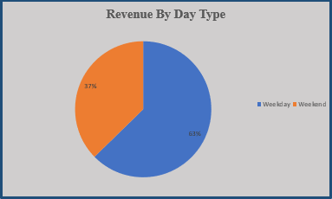
Day type vs Revenue insight
During Weekdays,the revenue totals 1070M Rupees,representing 63% of total revenue
During Weekend,the revenue totals 639M Rupees,representing 37% of total revenue
Customer Behavior : The chart can reflect customer preferences, with weekends attracting more guests, possibly due to higher prices,business-related stays.

Slide 7
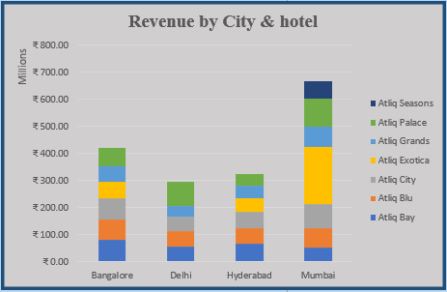
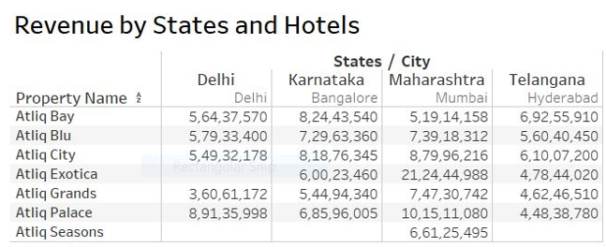
Revenue City & Hotel wise
Mumbai leads in revenue generation at 664M,followed by Bangalore at 417M,Hyderabad at 323M and Delhi 292M.
Hotel Contributions : Atliq Exotica plays a key role in driving revenue at 319M and least is Atliq Seasons at 66M.
Revenue Trends : Identifying cities or hotels with increasing or declining revenue can help pinpoint areas of growth or concern.

Slide 8
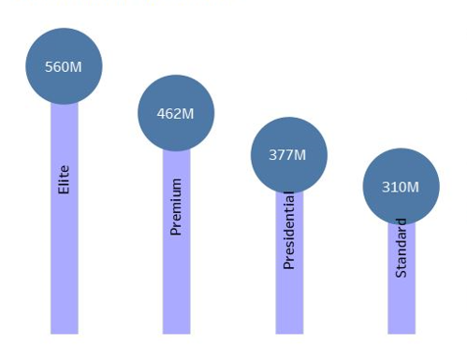
Class Wise Revenue
Class wise Performance : The chart highlights revenue distribution across different classes like Elite, Premium, Presidential, and Standard.
Higher revenue from Elite at 560M and lowest from Standard class at 310M.
Revenue Trends : Analyzing trends by class helps identify which segments are growing or declining, guiding pricing and service adjustments.

Slide 9
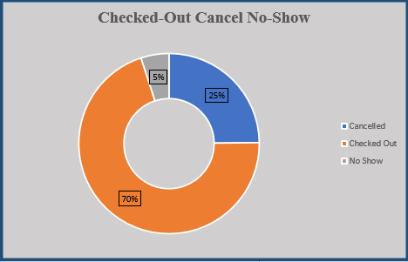
Checked-out , cancel and No show
Checkout (70%) indicates good occupancy and customer retention.
Cancellation (25%) signifies the need to reduce cancellations through better policies or incentives.
No-Show (5%): A smaller percentage but can impact revenue
Customer Behavior reflects that majority complete their stays, but a notable portion cancel or do not show up.

Slide 10
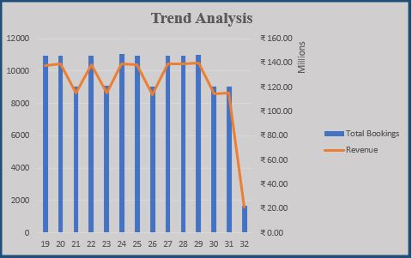
Trend Analysis
Weekly Booking Fluctuations (Bar Chart): Reflects customer demand patterns.
Revenue Growth Trend (Line Chart): revenue growth in line with bookings
Correlation Between Bookings & Revenue: Higher bookings generally result in higher revenue
Impact of Cancellations: High bookings with low revenue may signify cancellations.

Slide 11
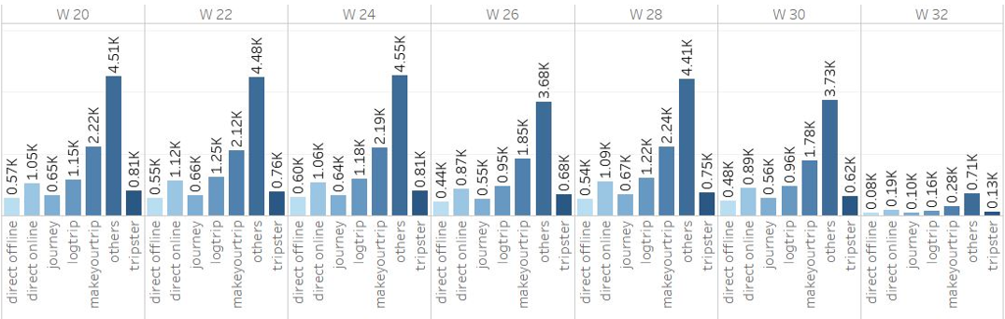
Weekly booking through various booking platforms
Direct offline bookings indicate a lower count which is 3.2K, whereas bookings through other platforms showcase higher ratings.
Notably, bookings via MakeYourTrip (second highest ratings) account are 19.95% of the total.
During weeks 20 to 32, W24 (June 5 - June 11, 2022) sees the highest Booking at 11.03K.

Slide 12
Major Insights
Weekday revenue surpasses weekend revenue, indicating stronger demand and booking activity during the workweek. Strategic focus?
Mumbai is the top-performing city in terms of earnings, with Atliq Exotica playing a central role in driving its revenue. Strategic Focus?
The Elite category generates the highest revenue compared to other room categories, likely due to its premium offerings and higher pricing. Strategic Focus?
The 70% checkout rate indicates solid occupancy and successful customer retention, suggesting that most customers are completing their stays. Strategic Focus?
Direct offline bookings are relatively low, totaling 3.2K, while bookings made through other platforms tend to have higher ratings, likely due to the convenience, promotions, and visibility these platforms offer

Slide 13


